Slide 1
Modern Security as a Continuous Process
Mark Lachniet, CISSP, CISA, PI
CDW Threat Check and Information Security Solutions Manager, CDW

Slide 2
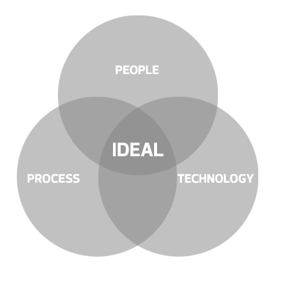
MY GOAL TODAY
Frame information security in a modern context (with ancient sources)
Share experience from two decade of hands-on work
Share learning from CDW’s 4000+ security assessments
Provide tactical and strategic guidance to step towards truly adaptive security
Balancing IT Security

Slide 3
Information Security – We Are At War
“War is the continuation of politics by other means.” –Admiral Carl von Clausewitz, famous Prussian general and military theorist
  Hacking is modern warfare, as well as modern crime
“Following the teachings of Sun Tzu, all warfare is asymmetric because one exploits an enemy’s strengths while attacking his weaknesses” -David L. Buffaloe, Association Of The United States Army
  Hacking favors the small, the agile, the creative
“When warranted, the United States will respond to hostile acts in cyberspace as we would to any other threat to our country. We reserve the right to use all necessary means — diplomatic, informational, military, and economic” - International Strategy for Cyberspace, The White House, 2011
  The US Military recognizes this and retains the right to respond with bombs

Slide 4
It’s not a matter of if but of when
“Companies have done a lot of things right, but it is not a matter of if but when they will come under attack. Attacks are becoming larger and more scalable, and because of the success of ransomware attacks that trend is likely to continue” -Alliance Manchester Business School
  We are all at risk, and the risk is will be with us forever
“It is the doctrine of war not to assume the enemy will not come, but rather to rely on one’s readiness to meet him; not to presume that he will not attack ; but rather to make one’s self invincible” –Sun Tzu, The Art of War
  All organizations have something that attackers want!
    Personal information – to steal your money or to blackmail you (see: OPM breach)
    Company information – to take your research and techniques and defeat you in the marketplace
    Political information – to embarrass you or for political advocacy
    Resources – to assist in attacking other targets, to create digital currency, digital contraband

Slide 5
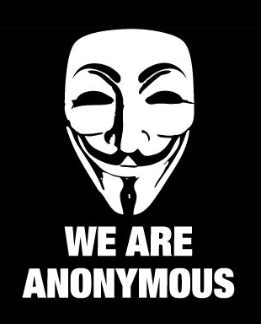
THIS ISN’T OUR BIGGEST EXTERNAL THREAT…

Slide 6

OR THIS…

Slide 7
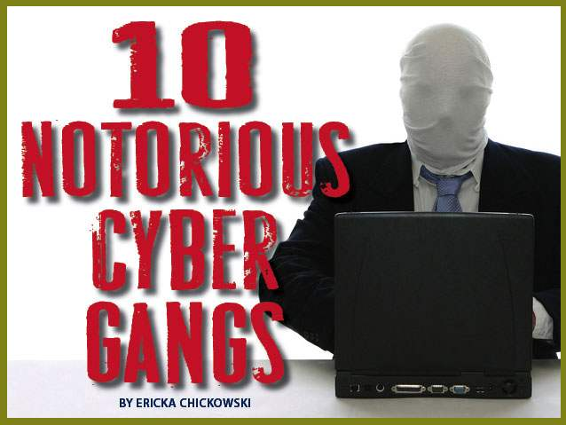
IT’S THIS!
“Hackers are breaking the systems for profit. Before, it was about intellectual curiosity and pursuit of knowledge and thrill, and now hacking is big business.” -Kevin Mitnick

Slide 8
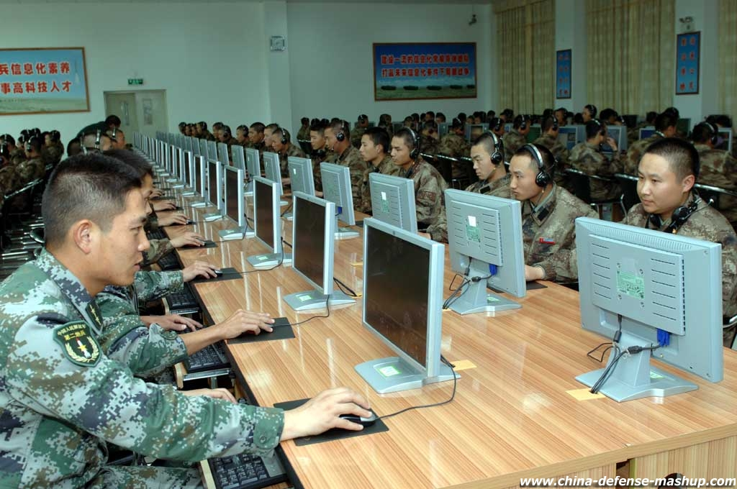

AND THIS!
Source: APT1: Exposing one of China’s Cyber Espionage Units, Mandiant®, 2013

Slide 9

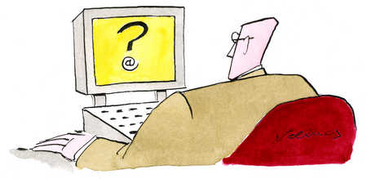
THE PROBLEM IS ALSO OURSELVES – OUR EDUCATIONAL SYSTEM
security
“Teaching cybersecurity is difficult in of itself. The technology, threats, and attack methods rapidly shift. It seems every eight to twelve months, the industry swings to an entirely new focus. A fellow security professional stated “if they are learning from a book, it is already outdated”. -McAfee
“Educators are ‘failing computer science students by deprioritizing cybersecurity training’ and ‘are inadvertently contributing to the lack of cybersecurity readiness in the U.S.’” – CloudPassage, National Cybersecurity Institute

Slide 10

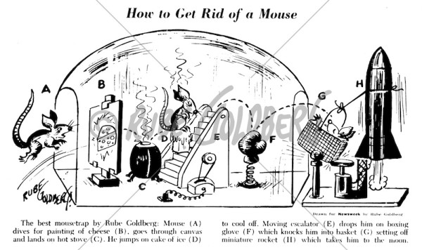

AND OUR COMPLEXITY
Hacker
Artificial Intelligence
“When [the enemy] prepares everywhere he will be weak everywhere” -Sun Tzu, The Art of War

Slide 11
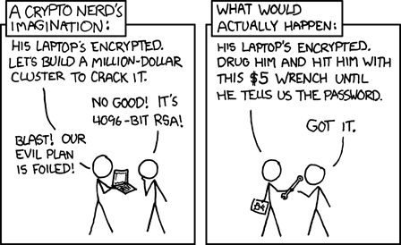
AND OUR ASSUMPTIONS…
“The force which confronts the enemy is the normal; that which goes to the flanks is extraordinary. No commander of an army can wrest the advantage from the enemy without extraordinary focus” –Sun Tzu, The Art of War
Criminals and malcontents are continuously changing their methods, so you need to also!
You need to formalize this change to make sure that it happens constantly
You need to constantly assess your technology and assumptions for flaws
You need to constantly learn from the industry and from your own successes and failures

Slide 12

THE WAY WE USED TO THINK ABOUT IT…
“When I wish to give battle, my enemy, even though protected by high walls and deep moats, cannot help but engage me, for I attack a position he must succor” - Sun Tzu, The Art of War
  We do not have the option to decline the fight
  As defenders, we must defend all points and win every time
  Attackers only need to win once

Slide 13
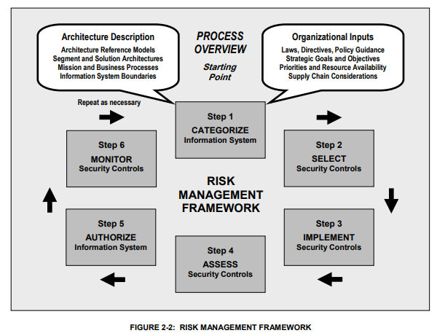
*NIST 800-37: Guide for Applying the Risk Management Framework to Federal Information Systems
The federal government provides free and truly useful advice on how to manage information security
In particular see NIST 800-37, 800-53
Standards are used for establishing minimum standards for federal agencies
Other entities that do work for the federal government are also required to comply with a subset of these controls to protect Controlled Unclassified Information (CUI) through DFARS / NIST 800-171
Commonly required for manufacturing and research, though many don’t know it
*http://csrc.nist.gov/publications/nistpubs/800-37-rev1/sp800-37-rev1-final.pdf

Slide 14
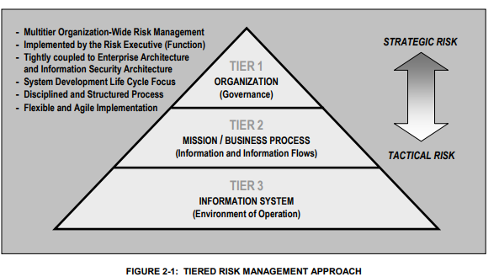
DIFFERENT CONTROLS FOR DIFFERENT PARTS OF THE ORGANIZATION
Every part of the organization has work to do – it is not enough to leave it to IT and audit
Tier 1: Policies and procedures, risk management, clear responsibilities
Tier 2: Define, document and prioritize core business processes
*Tier 3: Select, deploy and assess the efficacy of specific security controls ala NIST SP 800-53
*http://nvlpubs.nist.gov/nistpubs/SpecialPublications/NIST.SP.800-53r4.pdf

Slide 15
THE “CIA TRIAD” OF INFORMATION SECURITY & COSTS
All Information Security is based around one of three major “legs” of the CIA triad:
  Confidentiality – protect the data from inappropriate disclosure
  Availability – keep the systems functional
  Integrity – ensure that data cannot be inappropriately changed or modified
Take into account the costs and benefits of any security system
  Capital costs – initial and recurring
  Human resources – soft costs and FTEs
  Perception – within and without the org
  Legal – compliance, contracts and laws
  Competitiveness – compete with rivals for customers and employees
  And others….

Slide 16
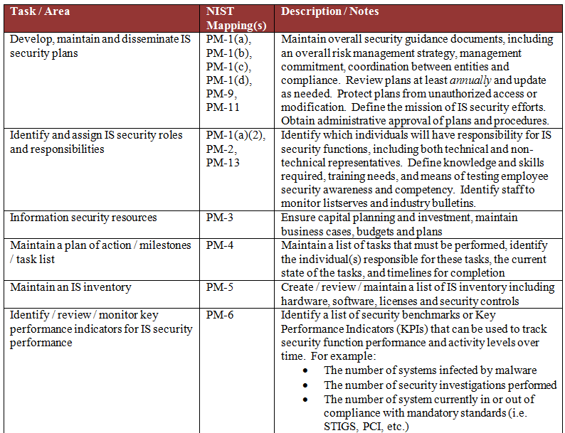
CREATE AN IT RISK MANAGEMENT WORKGROUP
From an example ITRMWG:
  Establish mandate and “big stick”
  Establish recurring schedule
  Team composition – include end users, non-IT management, risk management, compliance, legal
  Define specific tasks to perform
    Develop & maintain policies, procedures, documentation
    Action plan / open projects
    Track risk assessments, audit findings, compliance work
    Key Performance Indicators
    Awareness and education
    Budget
This structure will help you keep track of your work and establish a 3-5yr plan

Slide 17
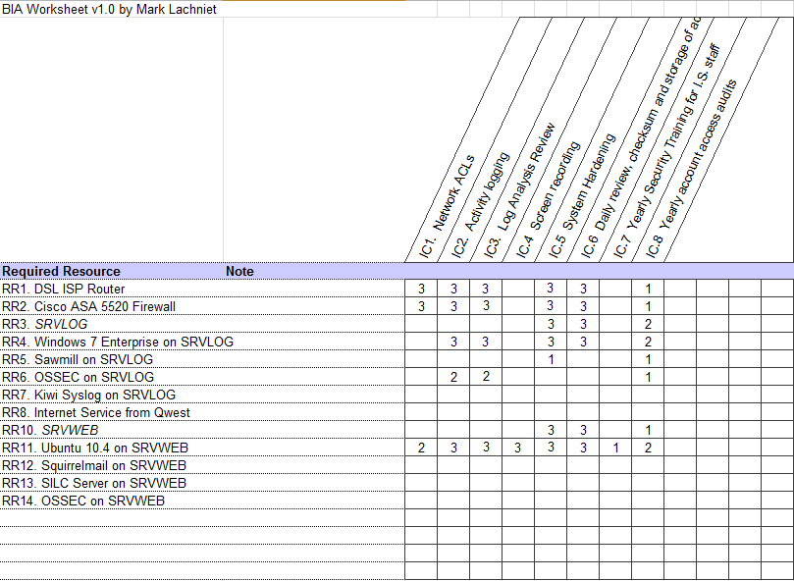
ASSESSING RISK & A BUSINESS IMPACT ANALYSIS
One excellent tool to find weak spots is a Business Impact Analysis
Map your resources (hardware, software, etc.) to your controls (for example from NIST 800-53)
This is especially helpful when adding new systems as you can see the supplemental work that will need to be performed
Also consider doing vulnerability scanning using a tool such as Tenable’s Nessus
Supplement with penetration tests and gap analysis assessments by outside assessors to get a fresh perspective

Slide 18




SECURITY ASSESSMENT FINDINGS
4,000 Assessments completed
>95% Ability to gain access
<10% Access detected
0 Times we tried to hide

Slide 19


TOP SECURITY ASSESSMENT FINDINGS
People/Process
#1: Insecure default configurations, gaps in patch discipline
#2: Bad passwords
#3: Arbitrary trusts
#4: Phishing, users like to click
Technology
#5: Application code issues
#6: Man in the middle
#7: Lack of encryption or porous implementation
#8: Mobile application vulnerabilities

Slide 20

LESSONS LEARNED: SEGMENTATION
BREAK YOUR SYSTEMS INTO DISCRETE “CHUNKS” THAT CAN ONLY FUNCTION BASED ON BUSINESS NEED
“When one man defends a narrow mountain defile which is like a sheep’s intestines or the door of a dog-house he can withstand one thousand” –Sun Tzu, The Art of War
  Network segmentation – allow only that which must talk to talk.
  Passwords – never re-use passwords on multiple systems, including local admin accounts
  Access rights – provide the least amount of rights possible to do the job
  Work environment – remote work environment
  Regularly verify that it is working

Slide 21
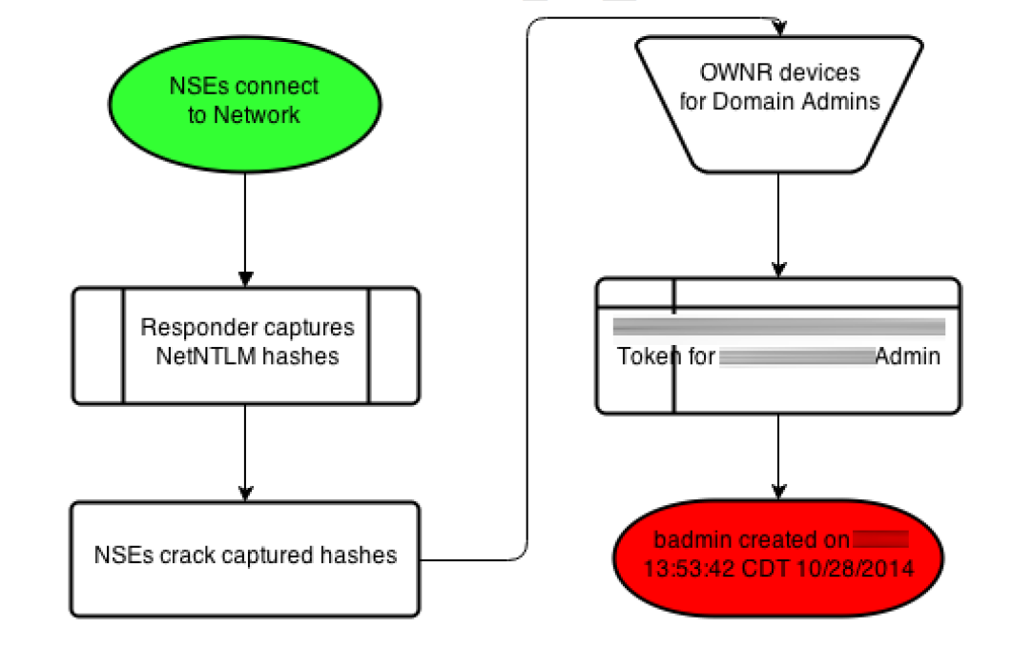
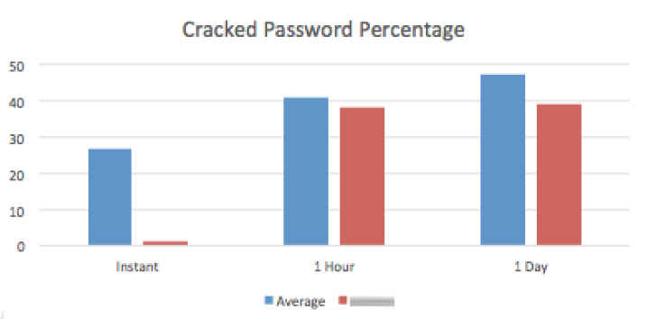
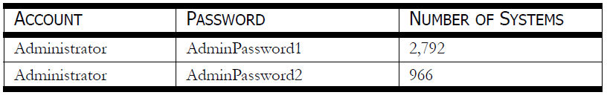
LESSONS LEARNED: SEGMENTATION
THE ABILITY TO “TALK” AND AUTHENTICATE BETWEEN SYSTEMS IS THE MAIN WAY SOPHISTICATED ATTACKERS “WIN”
Most of the time we get administrator access on hardware and software that is working as intended
This is done through “pivoting” and credential re-use

Slide 22
LESSONS LEARNED: VISIBILITY
Monitor Your Systems, Respond, Improve
“Subtle and insubstantial, the expert leaves no trace; divinely mysterious he is inaudible. Thus he is the master of his enemy’s fate” – Sun Tzu, The Art of War
  Network logging – Internet border points, proxy, VPN
  System logging – servers and devices, software, auth
  Encryption – Manage encryption such as SSL to provide visibility to areas you would otherwise not see
  Public profile – manage what the enemy can discover about you: metadata, forum postings, social media
  Tools to consolidate and present data
  Staff that will actually monitor and are able to do so
  “Purple Teaming” defense and offense work together

Slide 23
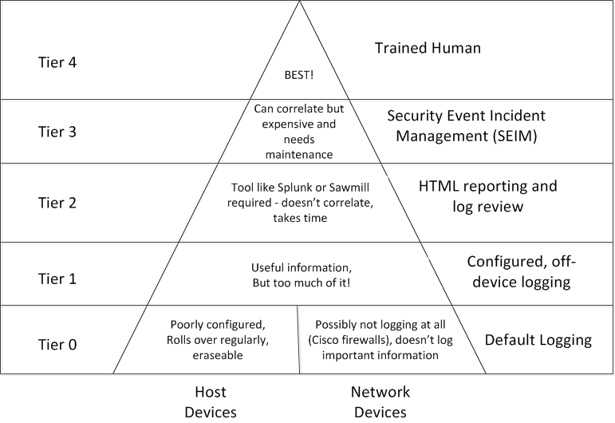
LESSONS LEARNED: VISIBILITY

Slide 24
LESSONS LEARNED: SYSTEM PATCHING
The Greatest Challenge – Keeping Current
“Therefore when I have won a victory I do not repeat my tactics but respond to circumstances in an infinite variety of ways” – Sun Tzu, The Art of War
  New attacks are created every day for technology we use, and we must defend it all
  Especially problematic areas are in third-party applications such as browser plugins
  Beware of the “we patch everything” trap – this is never true (some things can’t be patched)
  Question assumptions, remove your “blinders”
  Test systems constantly

Slide 25
LESSONS LEARNED: PASSWORDS
Passwords Are A Doomed Control
As an attacker, we can almost always succeed through password attacks
Complexity and length help but are not enough.
Multi-factor authentication is a must
Change from passwords to pass phrases
Encourage and support password safes
Clear policies and procedures for users
Beware of IT staff and their ways

Slide 26
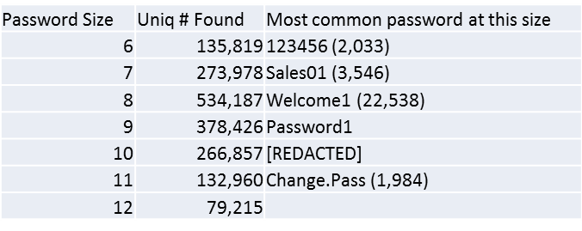
LESSONS LEARNED: PASSWORDS
CDW has been cracking passwords since 1998, have collected 933,979,289 password records
Among the most popular are those formatted with the season, capitalized, followed by the full year, such as Summer2014 (~10k)
“password” or variations (~40k)
Helpdesk or initial passwords (~60k)

Slide 27
LESSONS LEARNED: EDUCATION AND AWARENESS
A Chain Is Only As Strong As Its Weakest Link
Should be mandatory and managed
Many types required:
  End-user training – Phishing and Vishing
  IT Staff Training – Tools, Techniques, Tech
  Subject Experts – Networking, Security Tools
  Executives Training – Risk Management
  Partners and Clients – As much a risk as your own
Will require a lot of resources
You will never be able to train “enough” so establish relationships with outside experts

Slide 28
LESSONS LEARNED: INCIDENT RESPONSE READINESS
PLAN FOR THE WORST TO MINIMIZE IT
”If you know the enemy and know yourself, you need not fear the result of a hundred battles. If you know yourself but not the enemy, for every victory gained you will also suffer a defeat. If you know neither the enemy nor yourself, you will succumb in every battle.” - Sun Tzu, The Art of War
Create and practice a real Incident Response plan
Know where your critical data and systems are
Know what resources you have to identify a breach
Know the techniques of attackers and use this to make an actionable plan to evaluate and mitigate
Consider communication – law enforcement, SME, partners, internal and external stakeholders

Slide 29
THANK YOU
Mark Lachniet
Manager, Information Security Solutions
Mark.Lachniet@cdw.com

