Slide 1
Ransomware & Security Planning
November 16th, 2016
Dan Siebert
Inside Sales Engineer – Security
dansieb@cdw.com
Mark Lachniet
Manager – Information Security Solutions
marklac@cdw.com
Notes:
CDW Ransomware Description & Demo, November 2016
Host: Dan Siebert, Inside Security Sales Engineer, CDW
Panelist: Brian Self, Security Assessment Team, CDW

Slide 2
About The Speaker
Information Security Solutions Manager, CDW (previously Security Engineer)
  Presales and practice development
  Penetration testing
  Incident response & forensics
  Regulatory compliance (HIPAA, PCI, NIST 800-53)
Past employment:
  K-12 Technology Director (Holt Schools)
  Instructor, Masters in Information Assurance, Walsh College
  Consulting at Analysts International, Promethean Security
Industry certifications:
  Certified Information Systems Security Professional (CISSP)
  Certified Information Systems Auditor (CISA)
  Licensed Private Investigator #3701-205679 (Michigan)

Slide 3
About The Speaker
Historical perspective
  Hundreds of assessments over the last 15 years
  Penetration tests – i.e. “White Hat Hacking”
  Policy and Procedure Gap Analysis
  Incident Response / forensics
Prior to doing consulting I was a K12 technology director
  Approximately 3,500 kids
  Annual budget of $300k - $600k
  Team of 5-8 staff
  Inherited 12-site WAN with 56k Leased Lines, Netware 4.0, Groupwise
  Most board positions on Michigan Association for Educational Data Systems (mostly technical, non-curriculum)

Slide 4

About The Speaker
My main claim to K-12 fame:
1997 Linux Journal #41
Replaced 56k with WLAN
1-4 mile hops
Installed Linux firewalls
Squid proxy server
“naughty filter”

Slide 5
Agenda
Ransomware and effective controls
A bit about the CDW services team
The joys of NIST 800-53 and 462 page control frameworks
My top-10 list of important things to know and do
How CDW addresses these
No sales pitch, just facts
Q&A / Stump the Chump

Slide 6
Just pay up
“The ransomware is that good.”
“The easiest thing may be to just pay the ransom. The amount of money made by these criminals is enormous and that’s because the overwhelming majority of institutions just pay the ransom.”
Joseph Bonavolonta, Assistant Special Agent, FBI Cyber and Counterintelligence
Cyber Security Summit 2015
      Not being prepared can be devastating
Ransomware Demo
Notes:
Joseph Bonavolonta, Assistant Special Agent in Charge of the FBI’s CYBER and Counterintelligence Program in its Boston office – Quote his speech at the Cyber Security Summer 2015
Official FBI stance: The FBI doesn't make recommendations to companies; instead, the Bureau explains what the options are for businesses that are affected and how it's up to individual companies to decide for themselves the best way to proceed. That is, either revert to back up systems, contact a security professional, or pay.
The FBI website has some pretty good advice about preventing ransomware that comes close to what Naked Security advises, including:
Keep your anti-virus active and up to date. That means you’re more likely to block malware attacks proactively.
Patch your operating system and applications promptly. Many attacks rely on exploiting security bugs that are already have available fixes, so don’t make yourself low-hanging fruit.
Be suspicious of unsolicited emails, no matter how relevant they may seem. Avoid opening attachments and clicking on links in emails too, especially if you’re not expecting them.
Make regular backups, and keep at least one offline. That protects you from data loss of any kind, whether caused by ransomware, flood, fire, loss, theft and so on.
Most Security experts agree though, do not pay if you can avoid it.
Source: FBI’s Advice on Ransomeware? Just Pay The Ransom.”, The Security Ledger, October 22, 2015; https://securityledger.com/2015/10/fbis-advice-on-cryptolocker-just-pay-the-ransom/

Slide 7
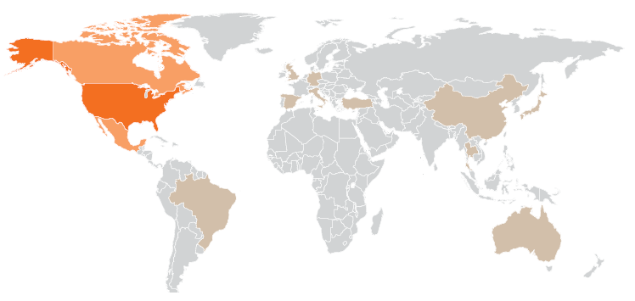
WHAT IS RANSOMWARE?
      IT is feeling the heat to protect its organization at every front
        Ransomware
        Lockscreen vs File- encrypting
      DoS & DDoS
      Botnets
        Bedep, Gamarue, Miuref
        Command & Control (C2 or C&C)
      Top Ransomware
      Locky
      CTB Locker
        TelsaCrypt
        Petya
        SamSam
        Cerber
        Cryptowall 4
      $325mil
      in damages caused by Cryptowall in 2015¹
      ¹ Lucrative Ransomware Attacks: Analysis of the Cryptowall Version 3 Threat,” Cyber Threat Alliance Founding Companies, October 2015
Ransomware Demo
Notes:
For readers that may not be familiar, ransomware is malicious software that is designed to hold users' files (such as photos, documents, and music) for ransom by encrypting their contents and demanding the user pay a fee to decrypt their files. Typically, users are exposed to ransomware via email phishing campaigns and exploit kits.
Ransomware Terms:
DDos: Distributed Denial of Service. DDoS is a type of DoS attack where multiple compromised systems, which are often infected with a Trojan, are used to target a single system causing a Denial of Service (DoS) attack. Victims of a DDoS attack consist of both the end targeted system and all systems maliciously used and controlled by the hacker in the distributed attack.
Traffic attacks: Traffic flooding attacks send a huge volume of TCP, UDP and ICPM packets to the target. Legitimate requests get lost and these attacks may be accompanied by malware exploitation. (i.e. DNS Amplification attack)
Bandwidth attacks: This DDos attack overloads the target with massive amounts of junk data. This results in a loss of network bandwidth and equipment resources and can lead to a complete denial of service.
Application attacks: Application-layer data messages can deplete resources in the application layer, leaving the target's system services unavailable.
Botnets: A botnet (also known as a zombie army) is a number of Internet computers that, although their owners are unaware of it, have been set up to forward transmissions (including spam or viruses) to other computers on the Internet.
Command & Control Servers (C2): In the field of computer security, command and control (C&C) infrastructure consists of servers and other technical infrastructure used to control malware in general, and, in particular, botnets. Command and control servers may be either directly controlled by the malware operators, or themselves run on hardware compromised by malware. Fast-flux DNS can be used as a way to make it difficult to track down the control servers, which may change from day to day. Control servers may also hop from DNS domain to DNS domain, with domain generation algorithms being used to create new DNS names for controller servers
Ransomware:
Lockscreen: Pops up a window that takes over your computer or mobile device, so you can’t use any other applications, make calls, or run your anti-virus. This ransomware usually accuses you of some sort of crime, but offers to let you keep on working once you have paid a “fine.”
File-encrypting: Leaves your applications running just fine, but scrambles your data files so you can’t open them any more. This ransomware usually pops up a window offering to sell you the decryption key.
Top Ransomware:
Locky: Locky is a type of cryptoware that has been very much in the spotlight since February. It is currently spreading like wildfire throughout Europe, mainly through malicious macros in Word documents: victims become infected when they download attachments from malicious emails. It encrypts files on their workstation… sometimes on an entire network. Furthermore, it evolves on a weekly basis, using new propagation methods. Some groups, for example, like to propagate malware by paying people who are specialized in exploiting security flaws. They make use of these vulnerabilities – zero-day in particular – to take control of computers and install Locky on them.
CTB Locker: CTB-Locker is another example of cryptoware. It was discovered in February and targets all versions of Windows (from Windows XP).Its preferred means of propagation is via booby-trapped emails. But it also uses compromised or malicious websites. Fraudulent email campaigns are effective since they target particular groups of users for whom the messages have been customised (they are in the users’ language, in particular). This makes them more impactful than standardized emails sent in bulk. Once triggered, it silently roams your computer in the background. It gets onto all of your hard drives and network shares, compiling a list of files (office documents, images, text files, etc.). It then moves them into a password-protected encrypted archive. In order to avoid detection by companies’ security experts, CTB-Locker has an anti-debugging mechanism: this way, it can identify virtual machines that are used by security experts for the purposes of analyzing malware and ensure that it does not execute on them. This particular ransomware is worryingly versatile: it has several variants, including the most recent – a server variant – which was discovered by one of our Stormshield experts.
TelsaCrypt: It analyses all of the drives on your computer, looking for data files. It ignores Windows itself and your applications so your computer remains operational. That way it can still access the Internet and you can pay the ransom. The data files are encrypted using AES encryption. Since AES encryption is among the most robust, it gives hackers complete control of victims’ files – they stand absolutely no chance of being able to recover them unencrypted. Some versions of this malware target gamers’ PCs in particular. It can infect computers in a variety of different ways, but mainly uses emails and exploit kits.
Petya: This ransomware is even more aggressive than Locky: as well as encrypting files, Petya encrypts the first few sectors of the system disk, preventing the PC’s operating system from loading. The result is that the targeted machine is completely inoperable. This highly aggressive attack strategy shows once again just how lucrative this type of malware can be. The pretext used for getting onto hard drives can be, for example, a CV emailed to a company’s human resources department. If the network becomes infected, the computer is completely unusable. Until the ransom is paid – which by no means guarantees the end of the affair – the company’s data is locked.
SamSam: The distinctive feature of this new cryptoware is the way in which it uses a new technique referred to as “Pass the Hash”. This is a major threat for network security in companies. PC pirates use this technique to bypass server authentication systems so they can access confidential information and critical applications. Once the attacker has compromised a targeted workstation, they can extend their grip over all of a company’s machines and its whole IT system. Since it can’t be blocked by anti-virus software, companies need to know how serious this type of attack can be and adopt a whole new attitude to the risks to which their IT infrastructure is exposed. Samsam recently hit MedStar Health, an organization that manages ten or so hospitals in Maryland and Washington. The hackers demanded a total of 45 bitcoins to unlock all of the affected systems – around US$18,500.
Cerber: Cerber is what is known as Ransomware As A Service (RaaS). Although it is not alone, RaaS is a trend that is just starting to rear its head and looks set to become much more widespread. Fraudsters can now purchase the malware and deploy it as and when they want. So the cyber criminal network is no longer just a small circle of programming experts and software writers. With all these dazzling ransomware innovations, the cybercrime black market is gradually becoming more fragmented and elaborate. in fact, cybercrime is becoming far more structured and is undergoing widespread commercialization.
Cryptowall: CryptoWall is a family of file-encrypting Ransomware that first appeared in early 2014. It is notable for its use of unbreakable AES encryption, unique CHM infection mechanism, and robust C2 activity over the Tor anonymous network. The miscreants running the CryptoWall operation also provide a free single-use decryption service to prove they hold the keys necessary to restore the hijacked files.
Source: ¹ Lucrative Ransomware Attacks: Analysis of the Cryptowall Version 3 Threat,” Cyber Threat Alliance Founding Companies, October 2015
Source: ² Cisco 2016 Annual Security Report, January 2016
Source: Ransomeware – should you pay?”, Paul Ducklin, March 19, 2015; https://nakedsecurity.sophos.com/2015/03/19/ransomware-should-you-pay
Source: The 2016 Ransomware Generation: Top 6 of the Last-Born Progeny and How You Can Protect Yourself”, Jennifer Legrand, Endpoint Security, Network Security, April 26, 2016; https://www.stormshield.eu/endpoint-security-2/the-2016-ransomware-generation-top-6-of-the-last-born-progeny-and-how-you-can-protect-yourself/

Slide 8
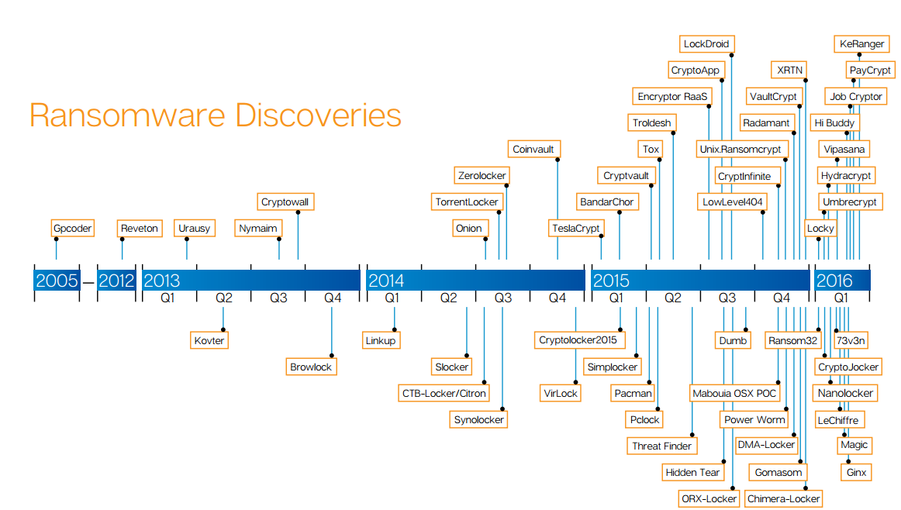
RAMPING UP
Ransomware Demo
Notes:
The FBI issued a warning in May saying the number of attacks has doubled in the past year and is expected to grow even more rapidly this year. As can be seen as a comparison, in Q1 of 2015 there were 4 ransomware variants. In Q1 of 2016 there were 15.

Slide 9
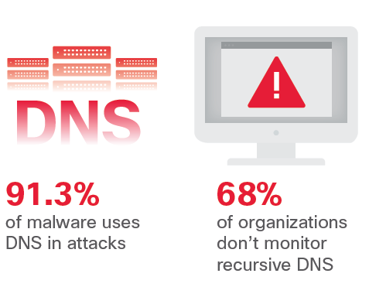
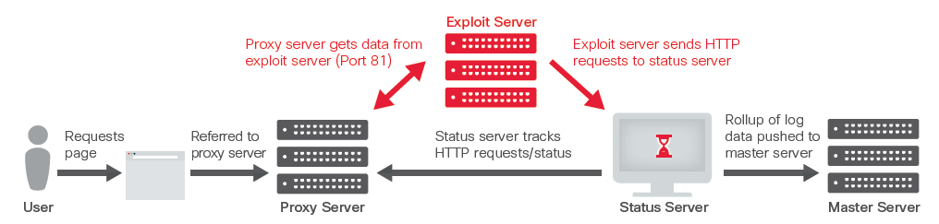
HOW DOES IT SPREAD
      Distribution Methods
      Email / Phishing
      Malvertising
      Abode Flash & Microsoft Silverlight
      Browser Plugins
      Open RDP ports
      DNS (Gain Control / Exfiltrate Data / Redirect Traffic)
      ² Cisco 2016 Annual Security Report, January 2016
Ransomware Demo
Notes:
Distribution Methods:
Email/Phishing: Phishing email messages, websites, and phone calls are designed to steal money. Cybercriminals can do this by installing malicious software on your computer or stealing personal information off of your computer. Cybercriminals also use social engineering to convince you to install malicious software or hand over your personal information under false pretenses. They might email you, call you on the phone, or convince you to download something off of a website.
Malvertising: Malvertising (a portmanteau of "malicious advertising") is the use of online advertising to spread malware. Malvertising involves injecting malicious or malware-laden advertisements into legitimate online advertising networks and webpages.
Open RDP Ports: Unlike typical ransomware infections, which involve the use of malicious email attachments in spam and phishing emails, some threat actors have begun going after Internet-connected remote desktop servers belonging to enterprises through brute-force attacks. Such access typically gives attackers the ability to search for and find a lot more servers and data to encrypt than other methods. This in turn creates a larger demanded ransom than the traditional drive-by infection, as the criminals know more about the compromised network and company.
DNS: DNS stands for "Domain Name System." It is the Internet standard for assigning IP addresses to domain names. A DNS acts like a phone book that translates human-friendly host names to PC-friendly IP addresses. It is typical for users to automatically use a DNS server operated by their own ISPs. Some users, however, choose to use third-party DNS servers for different reasons. ISP-operated DNS servers can be slow or unreliable, which is why third-party ones are preferred.
Captions:
Malvertising Exploit: Cisco also discovered that the servers that the users were connecting to did not actually host any of the malicious Angler activity. They were serving as a conduit. A user would get into the redirection chain and submit a GET request for a landing page, which would land on the proxy server. The proxy server would route the traffic to an exploit server in a different country, on a different provider. During our research, we found that a single exploit server was associated with multiple proxy servers. Cisco identified a status server that was handling tasks such as health monitoring. Every single proxy server that the status server was monitoring had a pair of unique URLs. If the path was queried, the status server would return an HTTP status code “204” message. The adversaries could uniquely identify each proxy server and make sure it not only was operating, but also that defenders had not tampered with it. Using the other URL, the attackers could collect the logs from the proxy server and determine how efficiently their network was operating.
DNS: Cisco’s analysis of malware validated as “known bad” found that the majority of that malware—91.3 percent—use the Domain Name Service in one of these three ways: To gain command and control; To exfiltrate data; and To redirect traffic. Despite adversaries’ reliance on DNS to help further malware campaigns, few companies are monitoring DNS for security purposes (or monitoring DNS at all). This lack of oversight makes DNS an ideal avenue for attackers. According to a recent survey Cisco conducted, 68 percent of security professionals report that their organizations do not monitor threats from recursive DNS. (Recursive DNS nameservers provide the IP addresses of intended domain names to the requesting hosts.)
Source: ² Cisco 2016 Annual Security Report, January 2016
Source: Ransomeware Spikes, Tries New Tricks”, Jai Vijayan, InformationWeek DarkReading, March 2, 2016,

Slide 10

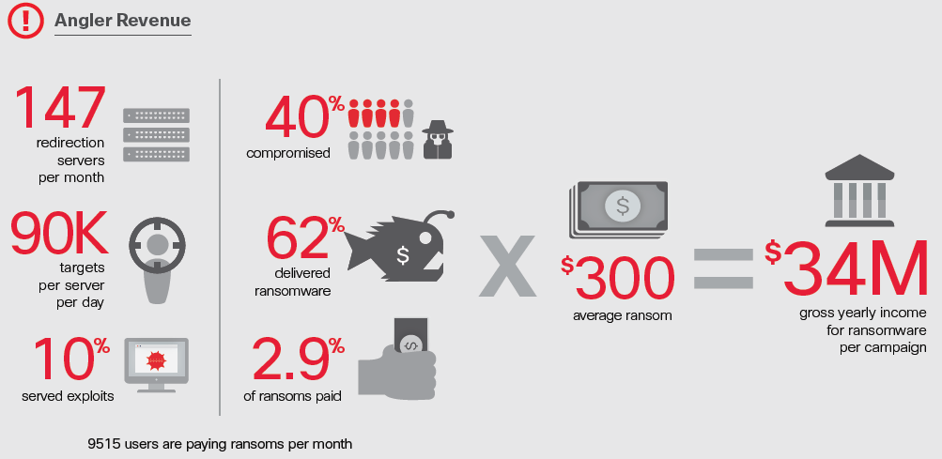
ASSISTANCE PLEASE
An exploit kit, or exploit pack, is a type of hack toolkit that cybercriminals seem to have favored in the last few years to perform Web-based attacks to distribute malware. Several kits have since been developed then sold or rented out like commercial products in underground markets.
      Common Exploit Kits
      Sweet Orange
      Angler
      Magnitude
      Rig
      Nuclear
      FlashPack
      Neutrino
      Fiesta
      Neosploit
      ² Cisco 2016 Annual Security Report, January 2016
Ransomware Demo
Notes:
Exploit Kits: An exploit kit is a software kit designed to run on web servers, with the purpose of identifying software vulnerabilities in client machines communicating with it, and discovering and exploiting vulnerabilities to upload and execute malicious code on the client. One of the earlier kits was MPack, in 2006.
Angler Revenue: “According to Cisco’s research, the primary actor responsible for about half of the Angler exploit kit activity in this particular campaign was targeting up to 90,000 victims per day. By our estimation, the campaign was netting the adversaries more than $30 million annually. “
Source: ¹ Lucrative Ransomware Attacks: Analysis of the Cryptowall Version 3 Threat,” Cyber Threat Alliance Founding Companies, October 2015
Source: ² Cisco 2016 Annual Security Report, January 2016
Source: Tools of the Trade: Exploit Kits”, Joshua Cannell, Malwarebytes Labs, February 11, 2013; https://blog.malwarebytes.org/cybercrime/2013/02/tools-of-the-trade-exploit-kits/

Slide 11






The darknet rises
    Hollywood Presbyterian Medical Center
    Email, Medical Records, X-rays, CT scan and lab work all suspended, systems were offline for 1 week
    Some Patients had to be transported to other hospitals
    FBI, LAPD and Cyber forensics Experts
    Ransom paid: 40 Bitcoins (~$17,000)
Ransomware has become the most problematic cyber threat
Hosting Companies are being exploited and don’t even know it
Crimeware and Ransomware are merging, as are the groups
      Ransomware is a HIPAA Data Breach
Healthcare and Critical Infrastructure are no longer immune
Ransomware as a Service (RaaS)
Ransomware
Notes:
Quote: “For instance, healthcare organizations that were hitherto off-limits for ransomware operators are no longer safe from the threat, ICIT said. The organization surmised the trend might have to do with the appearance of sophisticated Advanced Persistent Threat groups who are entering the stage because of the money to be made in such schemes.”
Quote: “Ransomware as a service is a variant of ransomware designed to be so user-friendly that it could be deployed by anyone with little cyber know-how. These agents simply download the virus either for free or a nominal fee, set a ransom and payment deadline, and attempt to trick someone into infecting his or her computer. If the victim pays up, the original author gets a cut — around 5% to 20% — and the rest goes to the "script kiddie" who deployed the attack.”
Hollywood Presbyterian Medical Center paid 40 Bitcoins or $17,000.
Source: ² Cisco 2016 Annual Security Report, January 2016
Source: Hollywood hospital becomes ransomware victim”, Charlie Osborne, ZDNet, February 15, 2016; http://www.zdnet.com/article/hollywood-hospital-becomes-ransomware-victim/
Source: Ransomeware Will Spike As More Cybercrime Groups Move In”, Jai Vijayan, InformationWeek DarkReading, March 16, 2016,
Source: Ransomeware Spikes, Tries New Tricks”, Jai Vijayan, InformationWeek DarkReading, March 2, 2016,
Source: There are now programs that anyone can use to extort money from you”, Dan Turkel, Business Insider, December 16, 2015; http://www.businessinsider.com/ransomware-as-a-service-is-the-next-big-cyber-crime-2015-12

Slide 12
Cryptowall

Slide 13
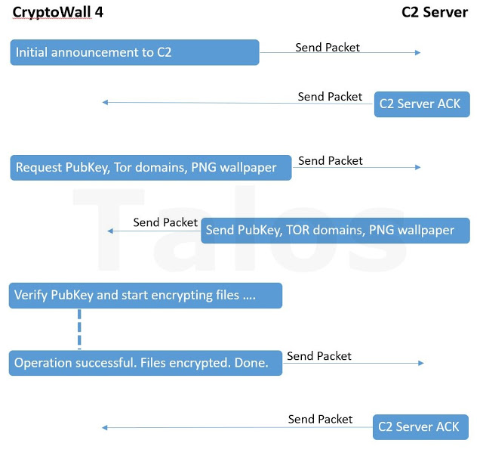
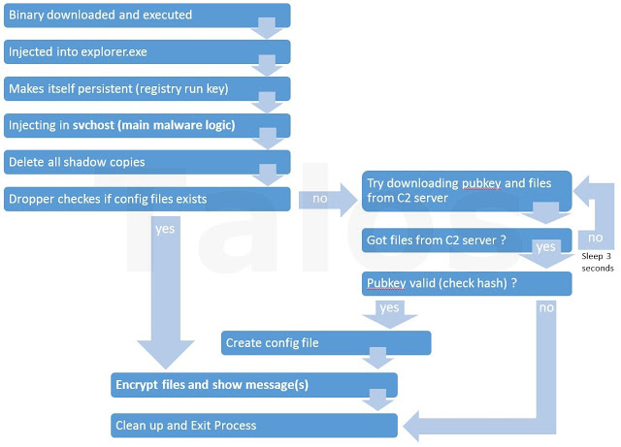
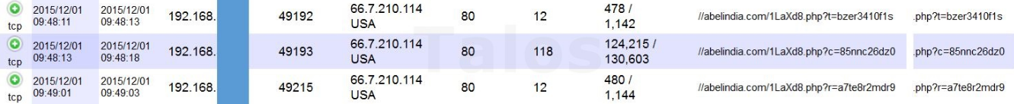
UNDER THE HOOD – CRYPTOWALL 4
Ransomware Demo
Notes:
Infection Process:
Host is infected by the malicious file (i.e. it is downloaded and executed).
Once infection starts, the file injects itself into explorer.exe to gain system access.
Next the file makes a registry key entry to make itself a persistent system process.
The infection now spreads to the svchost process. Injection into this process is increasing the privileged level of access to the compromised machine; this allows the deletion of all available shadow copies without the end user being prompted with the UAC (User Account Control) dialog to ‘Approve’ the deletion if the user has administrator level access rights.
Shadow copies are deleted to prevent backup and restoration.
For a new infection, a config file is created for the encryption process, which includes an RSA public encryption key from the command and control (C2) server. The config file also contains the three versions of the ransom note (HTML, text and PNG), and a list of the payment URL.
All files are encrypted with a temporary AES encryption key, which is later encrypted with the downloaded RSA public key and embedded in the encrypted files.
After the files are encrypted, the ransom is displayed.
Finally the process cleans itself up.
The Network Communication:
Make initial contact with the Command and Control (C2) Server.
C2 Server acknowledges request.
Infected machine sends a request for the Public Key, Tor Domains list (DNS), and PNG Wallpaper.
C2 Server sends the files and information using encrypted HTTP traffic.
The infected machine verifies the Public Key, and then begins encrypting.
Once the operation is successful, a message is sent to the C2 Server, which will respond with an acknowledgement.
Source: Threat Spotlight: Cryptowall 4 – The Evolution Continues”, Andrea Allievi and Holger Unterbrink with contributions from Warren Mercer, December 10, 2015; http://blog.talosintel.com/2015/12/cryptowall-4.html

Slide 14
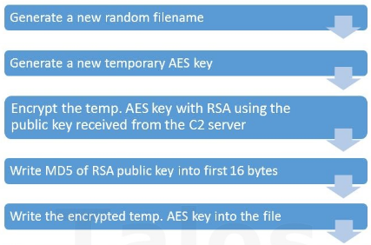
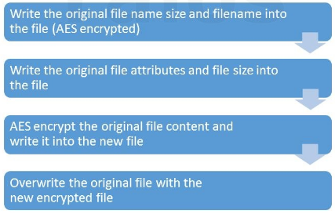
ENCRYPTION PROCESS
Ransomware Demo
Notes:
Encryption Process:
For files being attacked, a new file is created and a new random name is generated.
A new AES-CBC 256 key is generated using CryptGenKey and CryptExportKeyWindows Crypto APIs. This 32-byte key will be used to encrypt the entire file. This encryption is symmetric, meaning one key to encrypt and decrypt. The next encryption process (RSA), is asymmetric, meaning there is one key to encrypt (Public), and another key to decrypt (Private).
At this point CryptoWall 4 does a smart thing: it encrypts the generated AES key using the RSA-2048 public key (256 bytes in size) received from the C&C (using CryptEncrypt API). This will produce an encrypted 256-bit stream decryptable only by the bad guys.
The MD5 hash of the public RSA-2048 key is written in the first 16 bytes of the encrypted file
CryptoWall 4 writes the 256-bit encrypted stream.
The original file attributes and size are written to the next eight bytes.
The original file name is encrypted using the generated AES key and written with its size inside the new file.
At this point the real file content encryption takes place, the original file is read in blocks that are 512 KByte chunks. Each block is encrypted with the generated key, using an AES-CBC 256 algorithm, and written directly to the new file (together with the block size in the first four bytes).
Once completed all the CryptoWall 4 resources are released and the original file is now deleted in an interesting manner: As you can see from the pseudo code above, the sectors used for the original clean file are specifically overwritten on the hard disk to ensure that any potential data recovery process is difficult. This is an interesting and novel method used by the malware author to ensure the highest chance of payment; reducing the ability to recover lost files is beneficial to their business model.
Source: Threat Spotlight: Cryptowall 4 – The Evolution Continues”, Andrea Allievi and Holger Unterbrink with contributions from Warren Mercer, December 10, 2015; http://blog.talosintel.com/2015/12/cryptowall-4.html

Slide 15
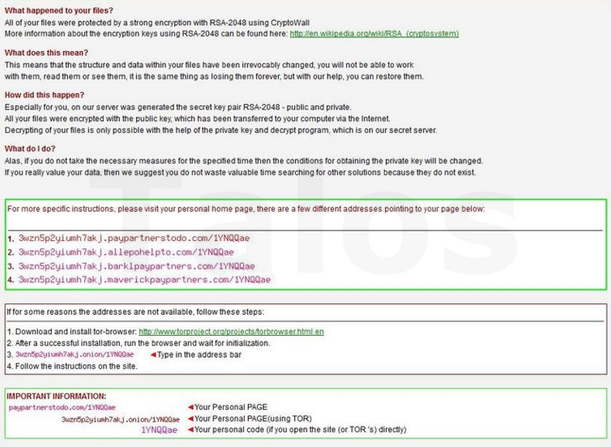
RANSOM NOTE
Ransomware Demo
Notes:
Ransom Note in English

Slide 16
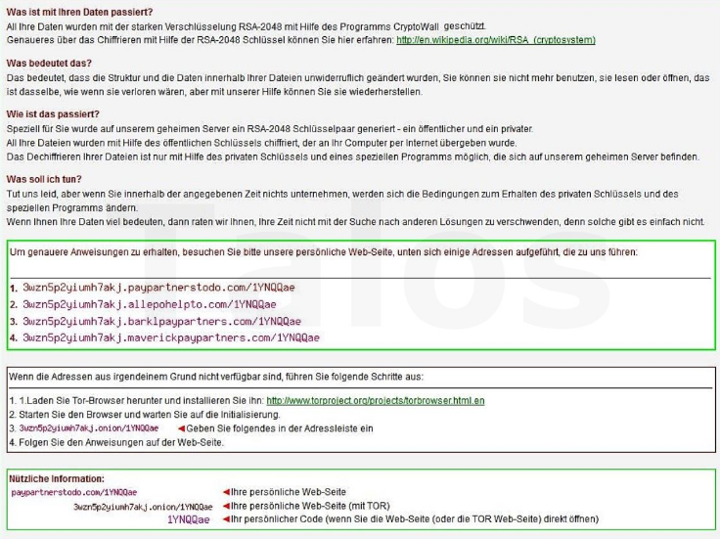
DIFFERENT REGION? NO PROBLEM
Ransomware Demo
Notes:
Same Ransom Note in German

Slide 17
solutions

Slide 18






Ransomware Protection guidelines
      Defense in layers...
      layers…
      layers...
  Backup
  Current backups provide the quickest recovery of lost data, just remember to keep data safe and the backup network separate
  Protect the Edges
  Implement Firewalls with Next Gen IPS and Malware Protection Services, as well as protections for Web and Email
  Patch Regularly
  In live systems, patching is difficult at best. Help Customers to understand the importance of creating a Patching Prioritization plan along with tools such as Microsoft’s SCCM and Cisco Prime
  Restrict User Rights & Access
  Limit User’s access to resources, including their machines (i.e. remove admin rights) to their Network Drives. Use tools like Varonis, Cisco ISE, Aruba ClearPass, Okta, Centrify, Imprivata, RSA to assist
  Use Security Suites at the Endpoints
  Protect the endpoints with a variety of tools, from Anti-Virus and Malware, to the latest Behavior tools
  Asset Management & Logging
  ArcSight, IBM, Q1, Intel Nitro, Qualys, Rapid7, Retina, SIEMs, Splunk, Tenable/Nessus
Ransomware Demo
Notes:
Protection Guidelines:
Protect the Edges: User features such as IPS, Malware protection, Web and Email services to protect the common entry points of Email and Malvertising.
Backup Data: The fastest way to regain access to your critical files is to have a backup of your data. Backups of data should take place not only for files housed on a server, but also for files that reside local on a workstation. If a dedicated piece of backup software is not an option, simply copying your important files to some sort of removable media and then removing that media from the system will provide a safeguard for your data being impacted by these types of threats.
Patch Regularly: Exploit kits hosted on compromised websites are commonly used to spread malware. Regular patching of vulnerable software is necessary to help prevent infection.
Use Security Suites at the Endpoint: With the endpoint being the final line of defense from any threat, a multi-faceted security solution should be employed. This solution should have protections for not just file based threats (traditional AV), but should also include download protection, browser protection, heuristic technologies, firewall and a community sourced file reputation scoring system.
Restrict User Rights & Access: Restrict admin rights on computers and mapped drives. Also employ dual-form authentication methods.
Asset Management & Logging: Use asset management and logging to verify assets are meeting patching and corporate requirements (i.e. endpoint posturing for anti-virus), and that breaches of policy and machines are logged and alerting.
Source: Ransomware Do’s and Don’ts: Protecting Critical Data”, Matt Sherman, Symantec Official Blog, February 18th, 2015; http://www.symantec.com/connect/blogs/ransomware-dos-and-donts-protecting-critical-data

Slide 19
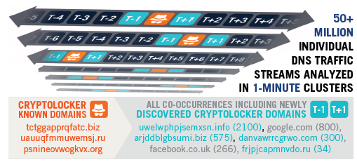
Quick protection with opendns
  The Achilles Heel: DGA-Based Botnet
  Infected systems must rendezvous with their botnet controller via one of many domain names generated every day. But if none of the domains can be resolved to the controller’s IP address, then the ransomware stays dormant.
  OpenDNS uses a predictive, network-level approach to combat DGA’s, along with their existing database of known malware sites via the 50+ billion DNS requests resolved daily.
DGAs enable malware to evade static blacklists or reputation systems, and avoid reactive counter-measures.
Ransomware Demo
Notes:
Big Data Delivers Protection Before Malware Analysis:
Antivirus and other security vendors’ time-intensive approach must collect and then analyze the binary code of every Cryptolocker variant. In the meantime, customers become victims as the polymorphic malware evades signature-based detection. OpenDNS uses a predictive, network-level approach, which discovers and blocks unknown domains that co-occur before or after Cryptolocker’s known domains via the 50+ billion DNS requests resolved daily by OpenDNS. As domain co-occurrences are validated by algorithmic classifications, they are quickly added as new known CryptoLocker domains, and then used in the next iteration.
As a result, OpenDNS blocks our customers’ infected systems attempts to phone home; containing the ensuing damage well before antivirus solutions.
First, Predict the Unknown…Then, Block the Known:
Researchers have reverse engineered the DGA. OpenDNS contributes to, and participates in, leading security research communities. As a result, we obtained the algorithm and have blacklisted every CryptoLocker domain name candidate through 2014 to proactively protect our customers.
What Are DGAs? (Domain Generation Algorithms)
To avoid such static detection mechanisms recent attackers have been taking advantage of various Domain Generation Algorithms (DGA) in choosing and updating the domain names of their C&C servers. DGA embedded in the malware generate a large amount of pseudo-random domain names within a given period, most of which are nonexistent. With the same random seed, e.g. time of the day or most popular tweets of the day, the attackers can generate exactly the same list of domain names remotely, among which they will only register a few. The malware will contact some or all of the domains generated by the DGA, giving its opportunity to be able to connect to the C&C server. The sheer amount of nonexistent domains produced by the DGA on a daily basis presents a great burden for security specialists if blacklisting is still to be pursued.
In addition:
Cyber-criminals need resilient ways for their malware to phone home to botnet controllers to receive new updates or commands days, weeks or years after the malware is distributed.
Embedding a hard-coded list of domain names or IP addresses is problematic. Malware samples are regularly captured and analyzed by security vendors or law enforcement authorities, which can then block or even takedown the botnet’s DNS infrastructure or IP networks.
Even designing malware to regularly receive configuration updates with new rendezvous points is vulnerable to timely analysis and takedown.
So cyber-criminals designed DGAs to produce, and then test, a number of candidate domains until a rendezvous point with the controller is found.
DGAs enable malware to evade static blacklists or reputation systems, and avoid reactive counter-measures.
Source: Cryptolocker: Containment is the New Prevention; https://www.opendns.com/enterprise-security/threat-enforcement/features/cryptolocker-containment-is-the-new-prevention
Source: Research Spotlight: Detecting Algorithmically Generated Domains”, Talos Group, August 8, 2015; http://blogs.cisco.com/security/talos/detecting-dga

Slide 20
TOP 10 LIST
Encryption C2
Payment MSG
NAME | DNS | IP | NO C2 | TOR | PAYMENT
Locky |  |  |  |  | DNS
SamSam |  |  |  |  | DNS (TOR)
TeslaCrypt |  |  |  |  | DNS
CryptoWall |  |  |  |  | DNS
TorrentLocker |  |  |  |  | DNS
PadCrypt |  |  |  |  | DNS (TOR)
CTB-Locker |  |  |  |  | DNS
FAKBEN |  |  |  |  | DNS (TOR)
PayCrypt |  |  |  |  | DNS
KeyRanger |  |  |  |  | DNS
Ransomware Demo
Notes:
A list of some of the most common Ransomware malware today, and the protocol they use to contact their Command & Control server for Encryption key and Ransom Note.
Locky: DNS & IP included in payload; payment form is through DNS
SamSam: The only one on this list to include all its information in the payload
TeslaCrypt: DNS for both Encryption and Payment
CryptoWall: DNS for both Encryption and Payment
TorrentLocker: DNS for both Encryption and Payment
PadCrypt: DNS for both Encryption and Payment
CTB-Locker: DNS & Tor for Encryption; DNS for Payment
FAKBEN: DNS for both Encryption and Payment
PayCrypt: DNS for both Encryption and Payment
KeyRanger: DNS & Tor for Encryption; DNS for Payment

Slide 21
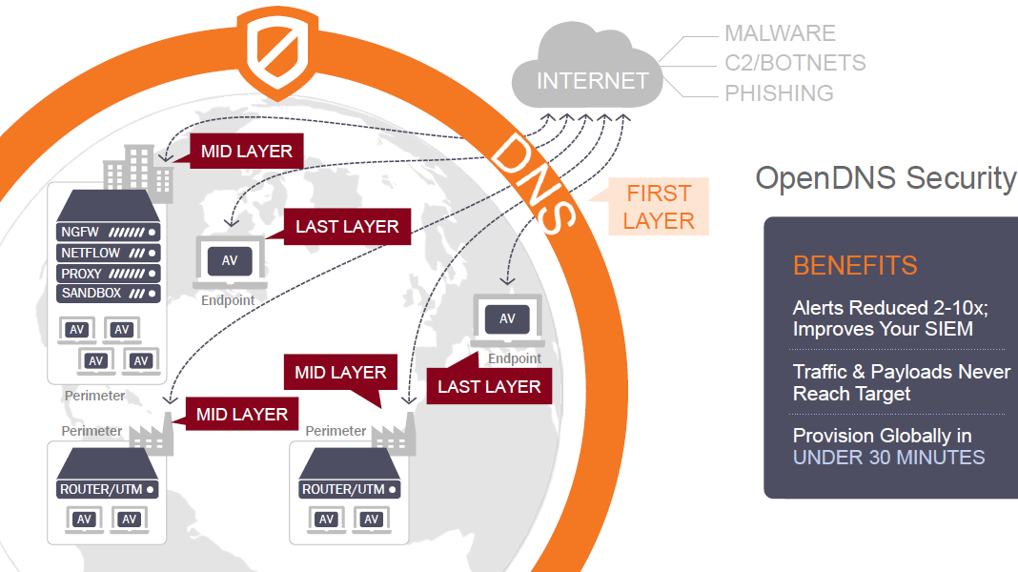
Defensive layers
Ransomware Demo
Notes:
Defensive Layers with OpenDNS
First Layer
OpenDNS
Second Layer
Next-Gen Firewalls
Routers with Unified Threat Management
Third Layer
Email and URL Filters
Third to Fourth Layer
Anti-virus

Slide 22
CDW’s Information Security Solutions Practice
      Highly specialized, technical, experienced, certified
      Research and development presented at nationally-recognized conferences
      Publishers of tools and original research used by penetration testers world-wide
      Sought-after thought leaders and consultants
      In practice since 1998
      Vendor-neutral, product-neutral discovery and evaluation of security weaknesses
      Custom-tailored engagements, hand-crafted work product, confidential consultation
      We go to the same conferences, read the same whitepapers, use the same (or better!) tools as our competitors and bad guys
Security Practice Overview

Slide 23
Lachniet’s Top-10 Controls List
Since Top-N lists are so popular, I made my own based on the things that slow me up the most when I am attacking an organization:
  Formal security management program – take time to do it right
  Software patching – especially third-party software like Acrobat
  Data Handling – data classification and handling, encryption
  Trust relationships – DNS, shared passwords and other windows “features”
  Accounts and passwords – too many admins, too guessable a password
  Regular security testing – test before someone else does
  Logging and log analysis – system visibility and awareness
  Incident response planning – communications and avoiding “chicken little”
  Border security – DMZ security and egress filtering
  Employee awareness – why not to open that attachment
I will talk about each of these and how we assess them

Slide 24
Formal Security Management – Use NIST 800-53!
If you take nothing else away today, remember THIS!
http://nvlpubs.nist.gov/nistpubs/SpecialPublications/NIST.SP.800-53r4.pdf
  “Security and Privacy Controls for Federal Information Systems and Organizations”
Free to you (if you don’t count taxes)
Last update April 2013
Used by all federal government agencies
Subsets required for any federal subcontractor (including universities doing research, manufacturers, etc.)
Excellent, actionable information! Not like your typical fluffy control framework
If anything, there is too much information you can use

Slide 25
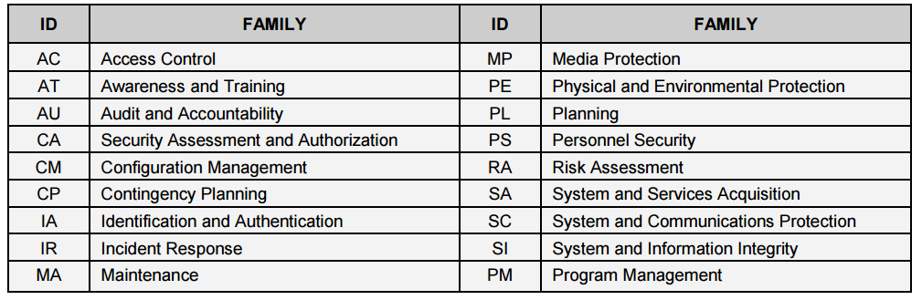
NIST 800-53
Covers a wide variety of technical and procedural stuff
Also many other NIST guidelines in specific areas (cloud, crypto, etc.)

Slide 26
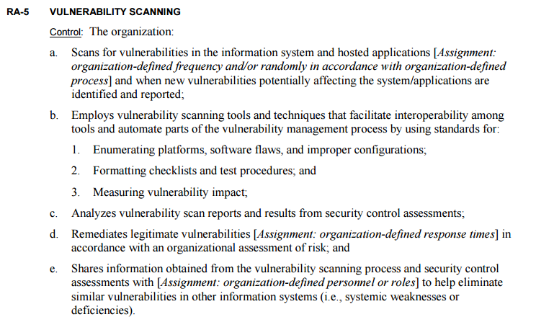
NIST 800-53
Example section:

Slide 27
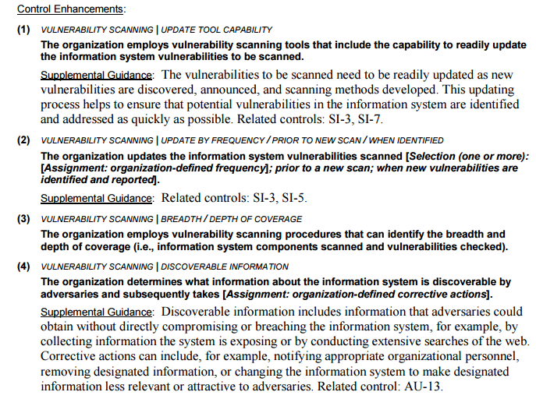
NIST 800-53

Slide 28
How we use NIST 800-53
Practices and procedures framework assessments
  On-site interviews of both technical and non-technical customer representatives
  Review documentation, policies and procedures
  Analyze systems, data flows, protocols and interconnections
  Standards-based compliance and readiness
  HIPAA / HITECH (Healthcare)
  NIST 800-53 (Federal government and contractors)
  PCI (Payment card industry)
Create recommendations that map back to NIST 800-53 with subjective metrics for priority and cost
A good way to evaluate simple improvements to people-based systems
A good way to identify new policies and procedures to create
A good way to find security flaws not otherwise easily found on network
A good way to prioritize projects over multiple years

Slide 29
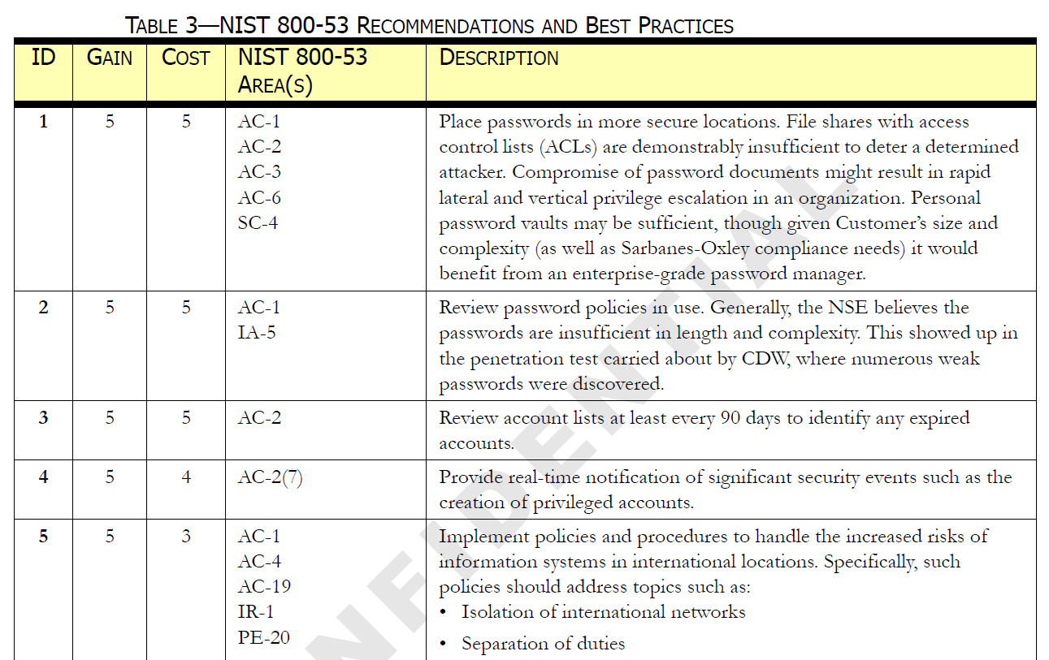
Example NIST-Mapped recommendations

Slide 30
Penetration Testing – Not Just about Patches
What a Penetration Test should be
  More than just running a scanner and handing over a report
  Actionable reporting on the important stuff, forget the little stuff
  Actual “hacking” by benevolent hackers
  Use the same tools and techniques as the bad guys
  Over the Internet or on-location
  “Capture the Flag” targets – go after specific systems or data types
  Networks, servers, workstations, wireless, Windows, UNIX, databases
  You name it, we can (probably) hack it
  Over 95% success rate getting administrator access when plugged into the internal network
  You can participate and learn! (purple teaming)

Slide 31
Penetration Testing – Not Just about Patches
Application security:
  “Deep dive” assessment of platforms and applications such as web servers with back-end SQL databases
  Deep understanding of application development best practices and technologies
  Source code review
  Vetting of third party products or services
  Use of cloud security
  Encryption
  Compliance with OWASP.ORG standards
Social engineering and phishing
  Sneaky and customized e-mail attacks and exploitation
  Telephone pretexting to obtain password resets or sensitive info
  Sneak into restricted areas

Slide 32
Lachniet’s Top-10 Controls List
Penetration testing, Gap Analysis, and how they apply:
  Formal security management program – take time to do it right
  Software patching – especially third-party software like Acrobat
  Data Handling – data classification and handling, encryption
  Trust relationships – DNS, shared passwords and other windows “features”
  Accounts and passwords – too many admins, too guessable a password
  Regular security testing – test before someone else does
  Logging and log analysis – system visibility and awareness
  Incident response planning – communications and avoiding “chicken little”
  Border security – DMZ security and egress filtering
  Employee awareness – why not to open that attachment

Slide 33
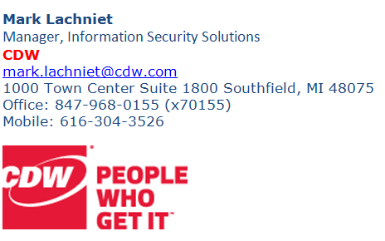
Q&A / War Stories / Thank You!

